Slide 1
Vector Tools
南开大学软件学院
王 靖

Slide 2
Goals
Review vector arithmetic
Relate geometric concepts to their algebraic representations
Describe lines and planes parametrically
Distinguish points and vectors properly
Exploit the dot product in graphics
Develop tools for working with objects in 3D space, including the cross product of two vectors

Slide 3
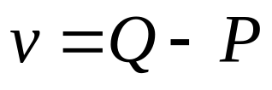
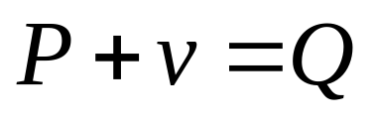
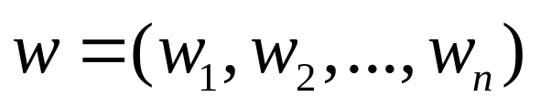
Review Vectors
The difference between two points is a vector.
P
v
Q
The sum of a point and a vector is a point
An n-dimensional vector is given by an n-tuple:

Slide 4
Vectors operations
a
b
a-c
2.5a
a
a+b
-a
c
a
The sum of two vectors
Scaling a vector
Subtracting vectors

Slide 5
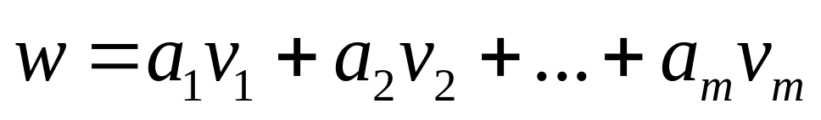
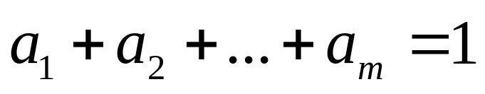
Vectors operations
Linear Combinations of Vectors
Affine Combinations of Vectors

Slide 6
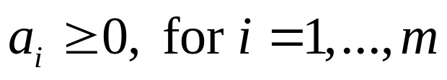
Vectors operations
Convex Combinations of Vectors
v2
a(v2-v1)
v
v1
V=(1-a)V1+aV2
q=a1V1+a2V2+a3V3

Slide 7
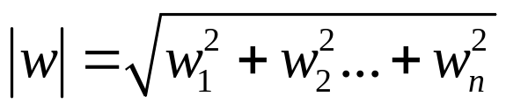
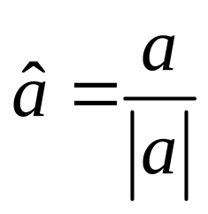
Vectors operations
The Magnitude of a vector, Unit vectors

Slide 8
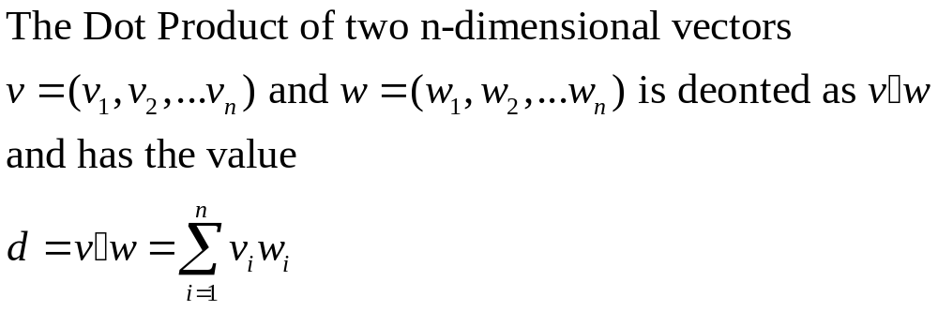
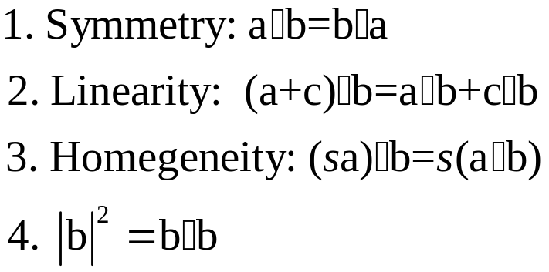
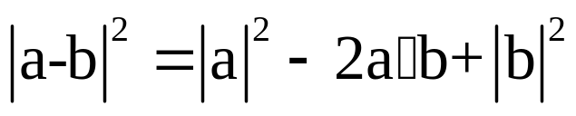
The dot product
Properties of the Dot Product

Slide 9
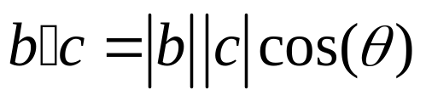
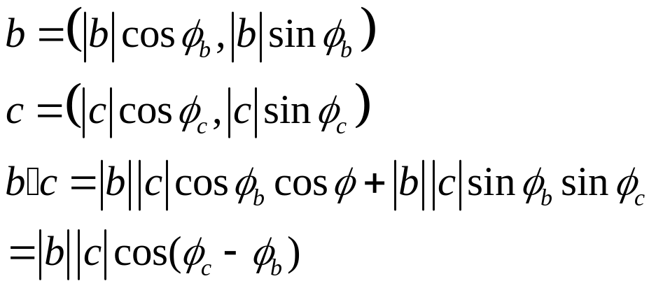



The dot product
The angle between two vectors
y
c
b
x

Slide 10



The dot product
b
b
b
c
c
c

Slide 11
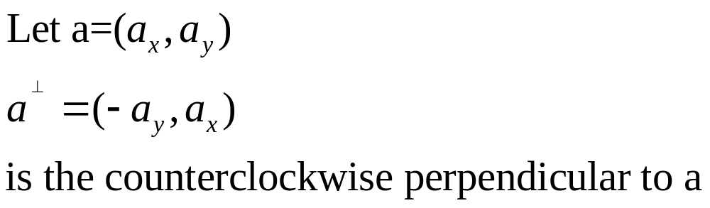
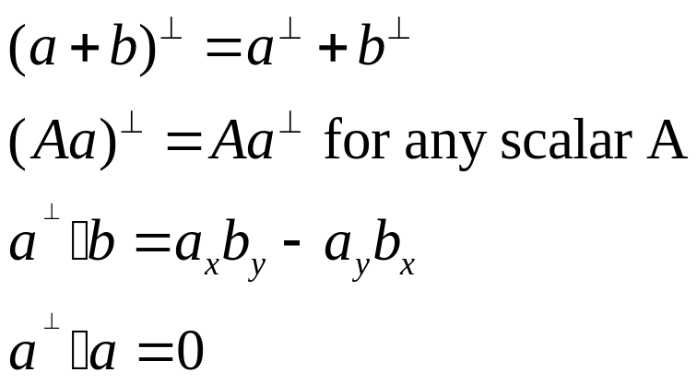
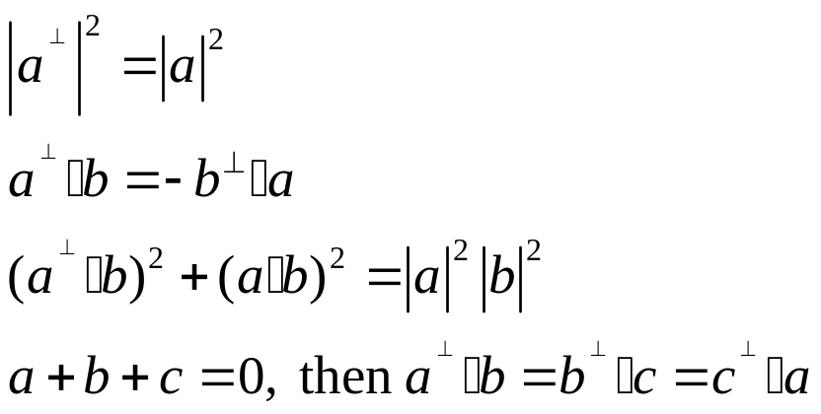
The dot product

Slide 12
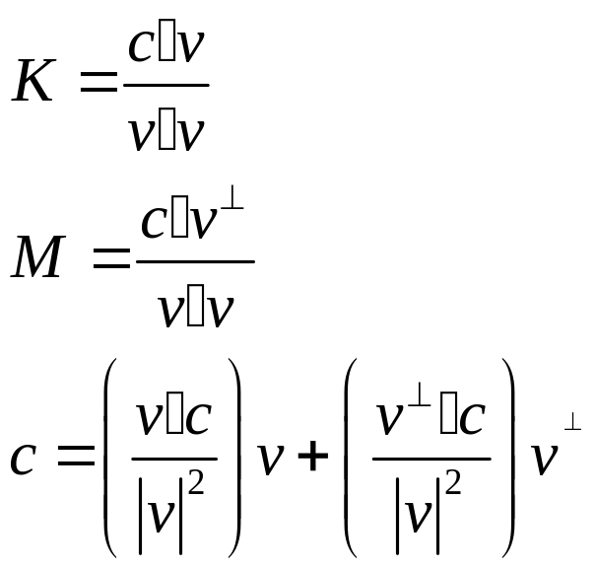

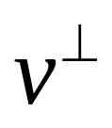


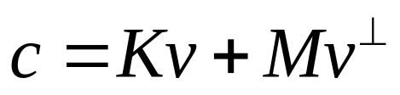
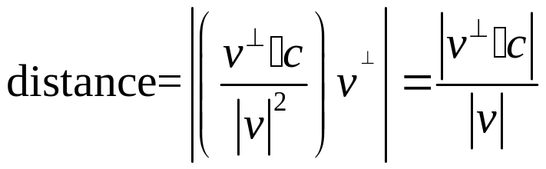
The dot product
C
A

Slide 13
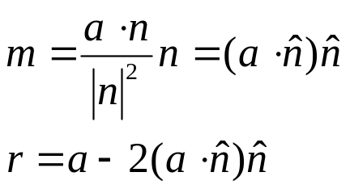
The dot product
a
n
r
m
-m
e
e

Slide 14
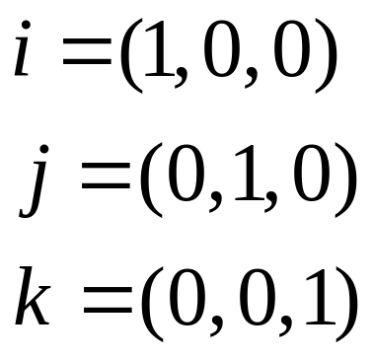
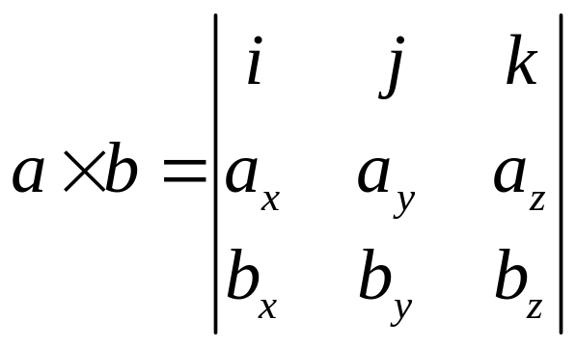
The cross product

Slide 15
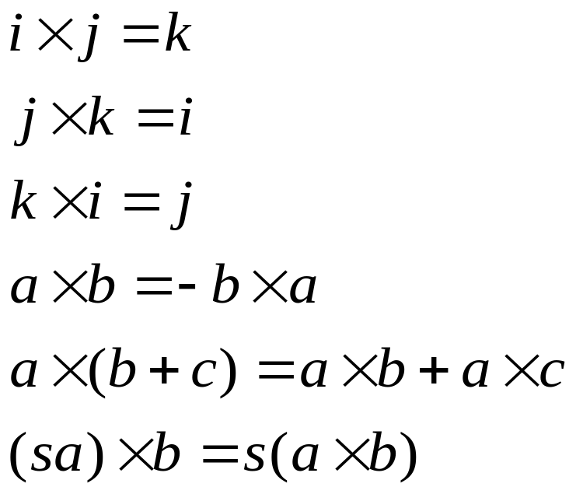
The cross product
antisymmetry
linearity
homogeneity
The cross-product operation is linear
The cross product of a vector with itself is zero
Ixj=k, jxk=I, and kxi=j

Slide 16
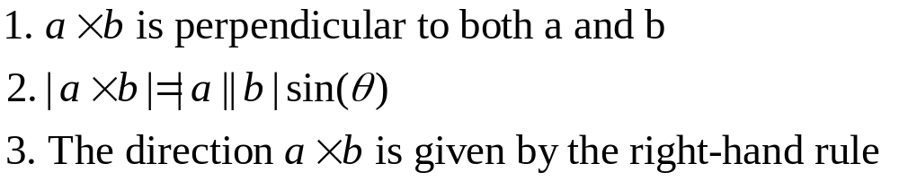
The cross product
axb
a
Area=|axb|
b

Slide 17
The cross product
b
P1
n=axb
a=P2-P1
b=P3-P1
P3
a
P2
axb
Is n normal to every line in the plane?

Slide 18
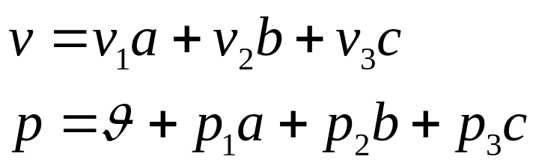


Representation of geometric objects
The difference between points and vectors
Points have a location, but no size and direction
Vectors have a size and direction, but no location
b
p
a
c

Slide 19
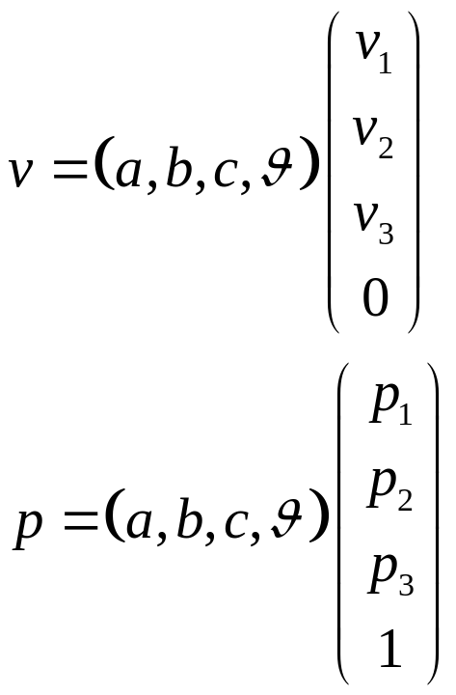
Homogeneous Representation
Some operations of points and vectors
The difference of two points
The sum of a point and a vector
The sum of two vectors
Scale a vector
Any linear combination of vectors, how about
points?

Slide 20
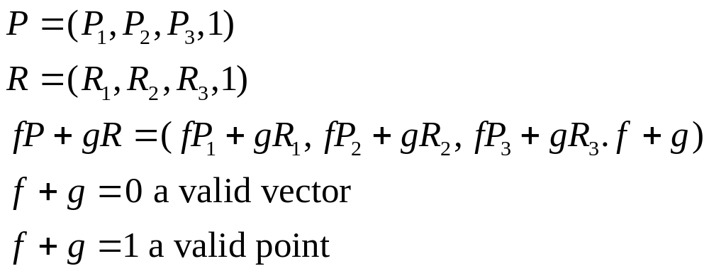
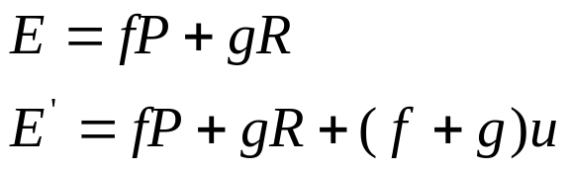
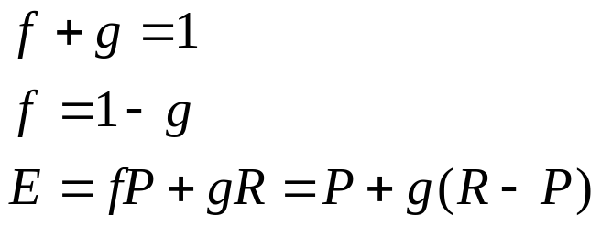
Affine Combinations of points
P1+P2
P1+P2
P1
(P1+P2)/2
P2

Slide 21

Interpolation of the points

Slide 22
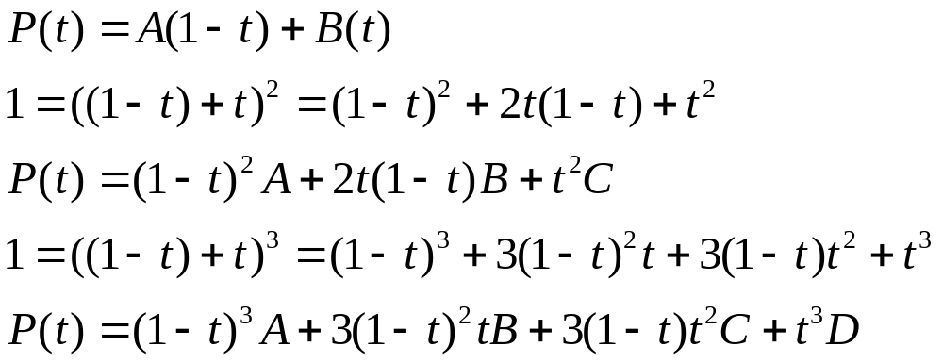
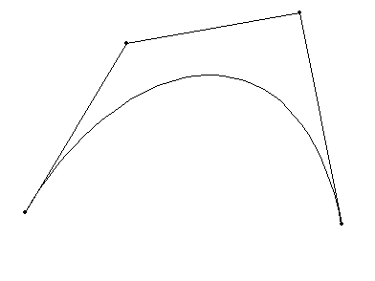
Interpolation of the points
C
B
A
D

Slide 23
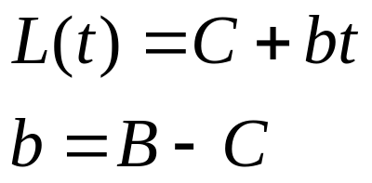
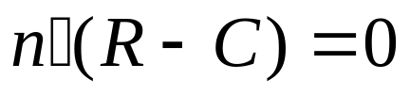
Representation lines and planes
Parametric representation of a line
t=1
t>1
t=0
B
R
C
t<0

Slide 24
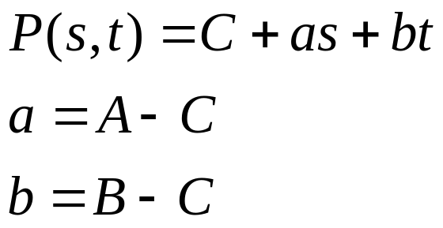
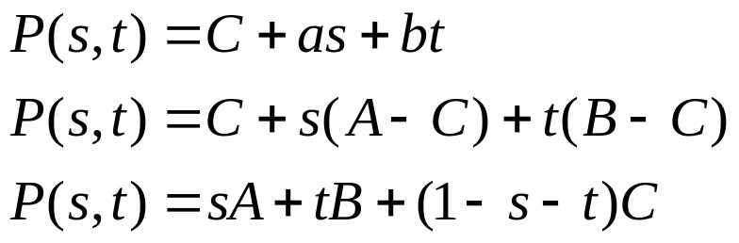

Representation lines and planes
n
B
b
c
a
A
Parametric form:
Point Normal form:

Slide 25
Representation lines and planes
Let plane P pass through (1,2,3), with normal vector(2,-1,-2). What is
the point normal form of this plane?
Find a parametric form for the plane 2x-y+3z=8
Given the normal n to a plane, what is an easy way to find two noncollinear
Vectors a and b that are both perpendicular to n?

Slide 26
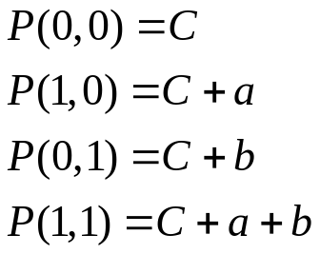
Representation lines and planes
b
(0,1)
Planar Patches
(0,0)
(1,1)
a
t
(1,0)
Parameter space
1
1
s
world coordinates

Slide 27
Find the intersection of two line segments
b)
c)
a)
B
B
B
D
D
D
A
A
A
C
C
C
e)
d)
D
B
B
D
C
A
C
A

Slide 28
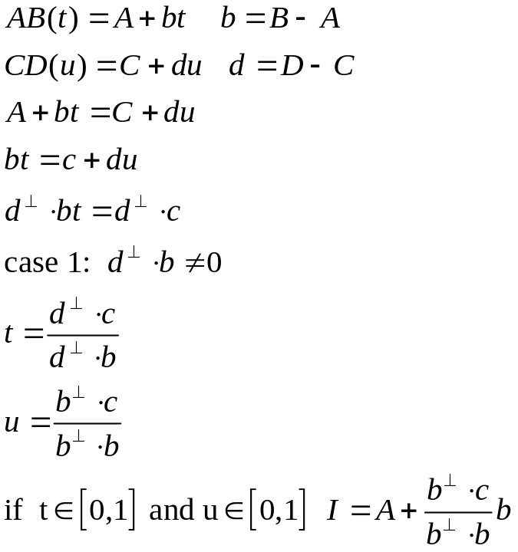
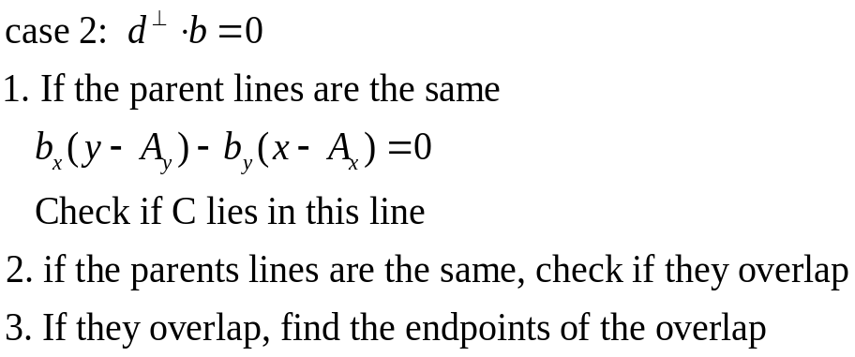
Find the intersection of two line segments

Slide 29
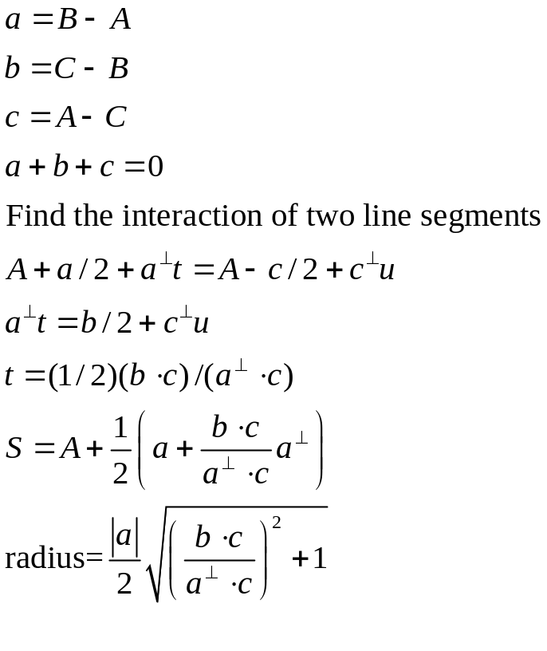
The circle through three points
A
Perpendicular bisector
s
B
C

Slide 30
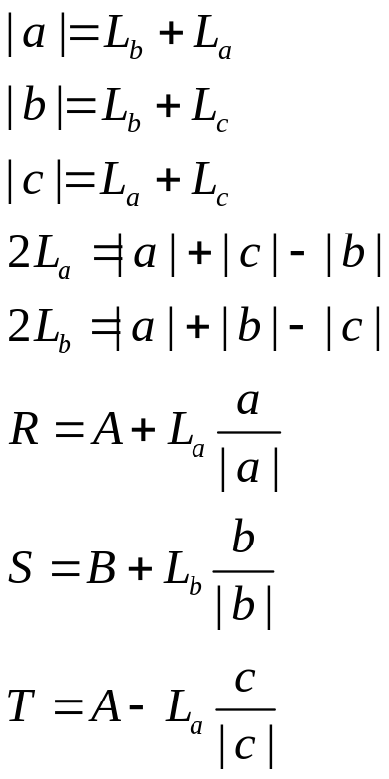
The inscribed circle
A
La
Lb
R
T
C
S
B
Lc
Lb

Slide 31

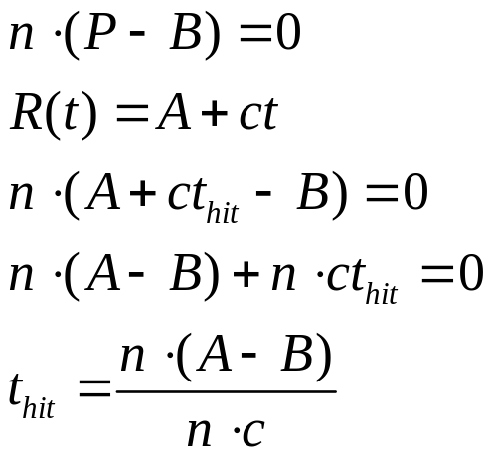

Interactions of lines with planes
n
n
B
c
Hit point
c
A
Hit point
B
A

Slide 32
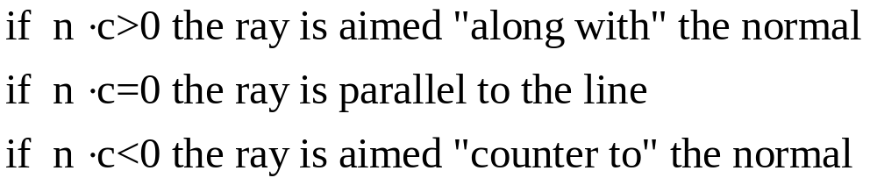
Interactions of lines with planes
n
n
c
c
A
A

Slide 33
Is Point Q Inside Convex Polygon P
P0
n1
P1
Q
P2

Slide 34
Polygon Intersection Problems
Outside
Half-space
L2
L2
L1
L0

Slide 35
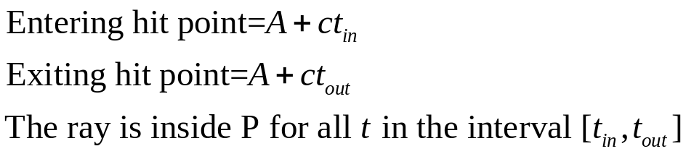
Ray intersections and clipping for convex polygons
P1
C
A
P2
P0
n1
L1

Slide 36


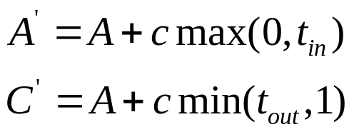
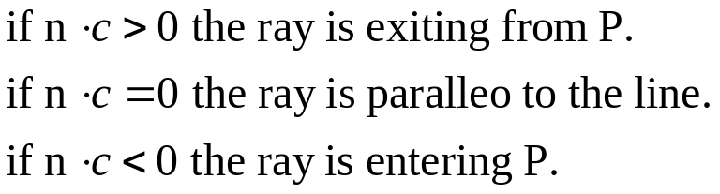
Ray intersections and clipping for convex polygons
1
C
1
1
0
C
0
C
A
0
A
A
For each bounding line, we find
The hit time of the ray with the bounding line
Whether the ray is entering or exiting the polygon

Slide 37
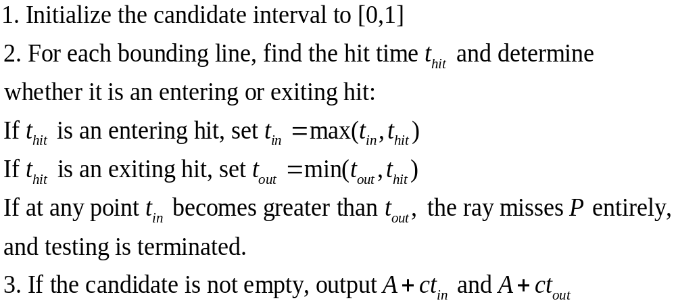
Ray intersections and clipping for convex polygons

Slide 38
Ray intersections and clipping for convex polygons
A
L5
Line test tin tout
0 0 0.83
1 0 0.66
2 0 0.66
3 0 0.66
4 0.2 0.66
5 0.28 0.66
L0
L4
C
L1
L3
L2

Slide 39
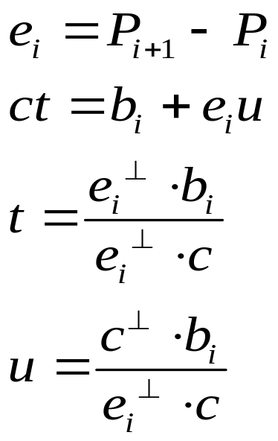
Clipping against arbitrary Polygons
A
P4
P3

Slide 40
Clipping a Polygon against a convex polygon
inside
outside
inside
outside
i
p
p
s
s
inside
outside
inside
outside
S and p inside: output p
S inside p outside : output i
S and p outside: no output
S outside p inside: output i and p
s
p
p
i
s

Slide 41
Clipping a Polygon against a convex polygon
a
b
1
4
2
1
2
3
e
g
e
6
g
f
f
5
d
c
d
c
1,2,c,d,e,f,g
3,1,4,5,d,e,f,6
1
4
1
4
3
3
e
e
12
6
6
9
10
7
8
9
10
7
11
d
3,1,4,7,8,e,9,10,6
3,1,4,7,11,12,e,9,10,6

Slide 42
Clipping one polygon against another: weiler-atherton clipping
a
A
c
C
6
B
1
5
3
sublist
2
4
b
start
restart
a 1 b 2 c 3 4 d 5 6
d
D
A 6 3 2 B 1 C D 4 5
Sublist: a,1,b,2,c,3,4,d,5,6
Cliplist: A,6,3,2,B,1,C,D,4,5
visited
visited
cliplist

Slide 43
Boolean Operations on Polygons
A∩B
A∪B
A－B
A
A
A
B
B
B

